Slide 1
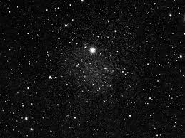
MEGALITHISM
AND THE DARK BLUE SKY
ASTRONOMICAL MAPS,
CROMLECHS AND MENHIRS
In Alentejo and in the alqueva region
Michela Zucca
Servizi culturali

Slide 2
For a long time, megaliths were considered to have had primarily funerary purposes, which is reflected in the names given them such as 'Chamber tombs', 'Burial-mounds', 'Passage graves', 'Gallery graves' etc. This assumption is now in question...
Megalithism as been associated with prehistoric astronomy in Europe for quite some time now. Various comprehensive surveys of these monuments suggest that they are oriented not randomly but to particular areas of the horizon where astronomical events, such as sunrise or moonrise could be witnessed and even predicted.
Michela Zucca
Servizi culturali

Slide 3
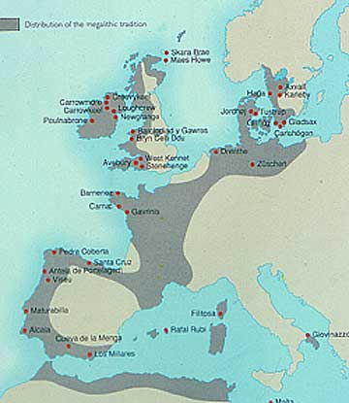
megaliths are directly related to astronomical phenomenon, the sun, moon, and stars. These massive stones sometimes weighing more than 50 tons, appear all over Atlantic Europe until Syberia.
Michela Zucca
Servizi culturali

Slide 4
In Neolithic Europe, there is evidence of at least two marked phases of cultural development involving the development of large, civil-scale constructions involving primary astronomical orientations and alignments at several 'megalithic complexes' along the Mediterranean and Atlantic coastline of Europe, many of which were positioned at astronomically significant latitudes (such as Stonehenge, Orkneys, Carnac, Evora).
Astronomy was strictly linked with the fertility religion and with everyday life: the first sacred circles were the place s
where women went to give birth, and are connected to the moon, the stars, the night.
Michela Zucca
Servizi culturali

Slide 5
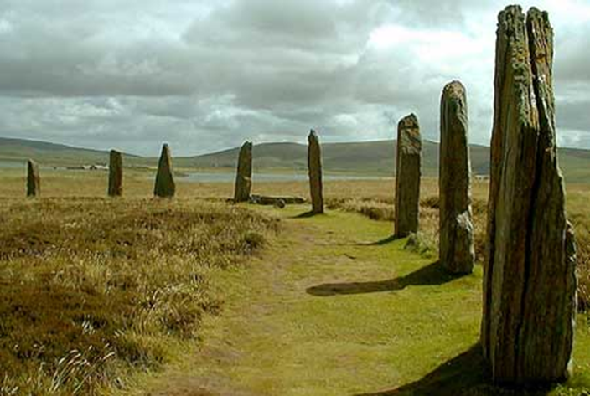
Cromlech in Orkney Island, UK. Most of the menhirs are linked
with women and fertility rituals, and later with the «witches» .
Michela Zucca
Servizi culturali

Slide 6
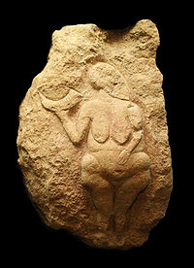
Connections of women with the dark sky, the moon and the stars is very ancient: the 25,000 year old figure from Laussel, Dordogne, holds a crescent-conch shape with 13-lines on it. The 13 lines could refer to the 13 lunar/menstrual cycles each
solar year.
Michela Zucca
Servizi culturali

Slide 7
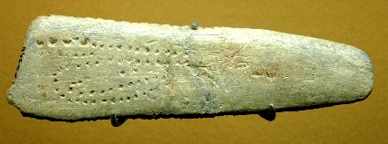
Twelve km from the goddess, it was rescued the instrument she was probably holding: a bone plate about 30,000 years old, from Abri Blanchard (Dordogne, France) which is said to represent the waxing and waning
moon positions in serpentine form.
Michela Zucca
Servizi culturali

Slide 8
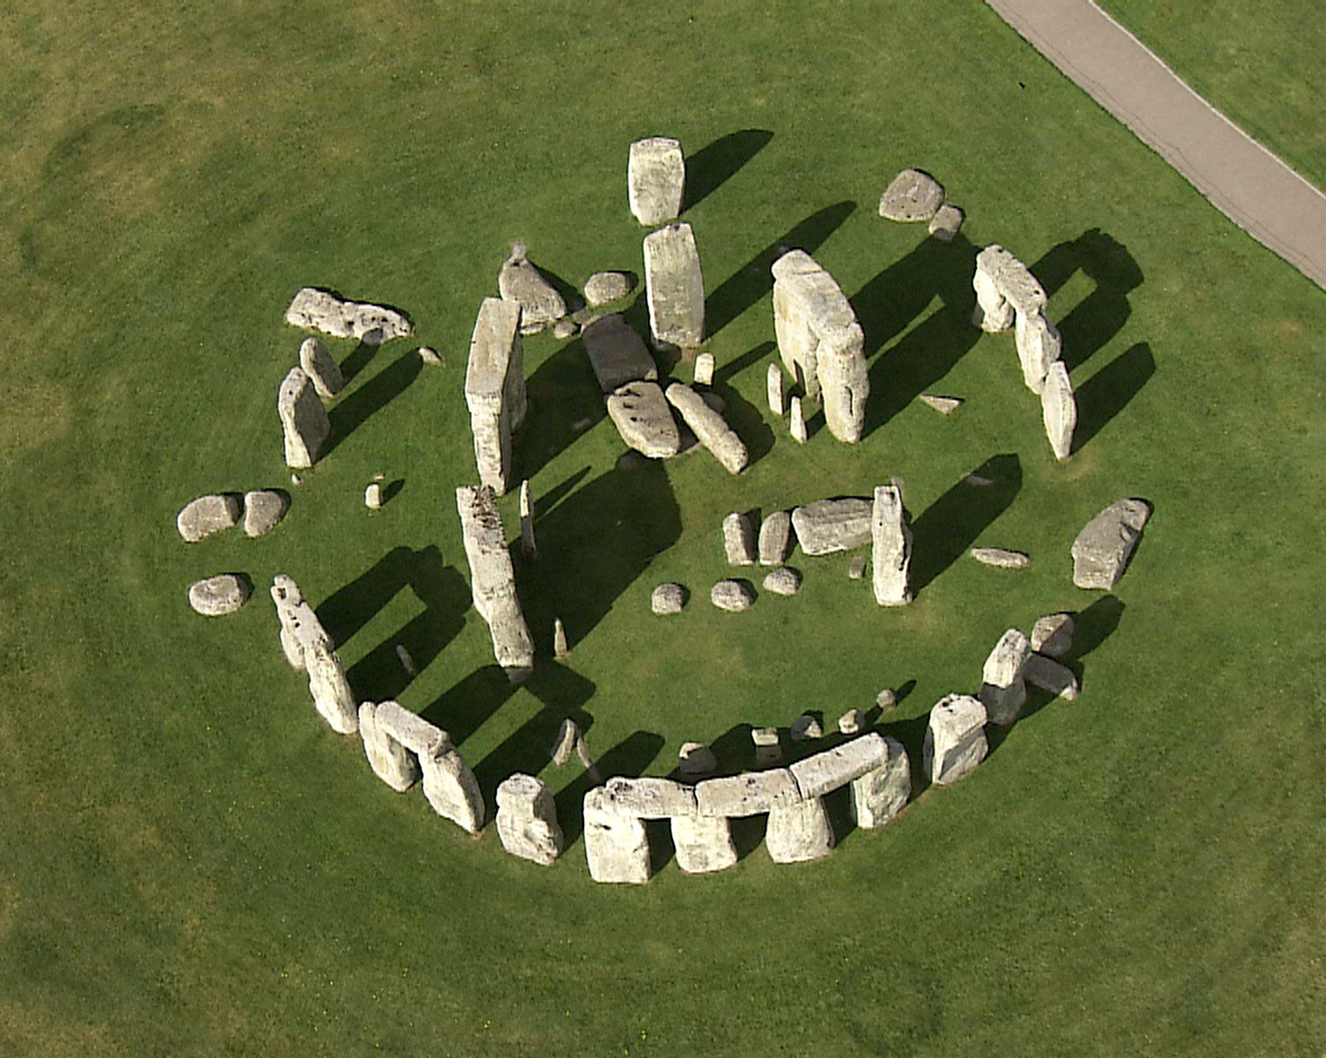
Stonehenge, UK.
The most famous
2.500 b.C.
Over 130 megalithic sites exists in the alqueva region: it must have been of major importance
Michela Zucca
Servizi culturali

Slide 9
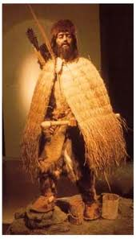
The first megaliths were built at the turn of the Middle Neolithic, around 4000BCE. Small communities sustained themselves by little game hunting, gathering of vegetals, and transhumant pastoralism. The raising sheep and goat suggests that spring and summer were spent on high ground pastures and winter
on lower ground.
Michela Zucca
Servizi culturali

Slide 10
Archaeologists thought the megalith builders' way of life as semi-nomad pastoralists was tied to the orientation of the dolmens: the monuments were built during the winter seasons when the pastoralists would be in lower ground, and thus an understanding of the relation between the sun and the seasons was of importance. However not all measured dolmens fit this picture. To test this seasonal model a new survey was conducted during 2010 in Central Portugal, in the Montego area. Some of the survey suggest a non-solar alignment, possibly lunar or even stellar.
Michela Zucca
Servizi culturali

Slide 11
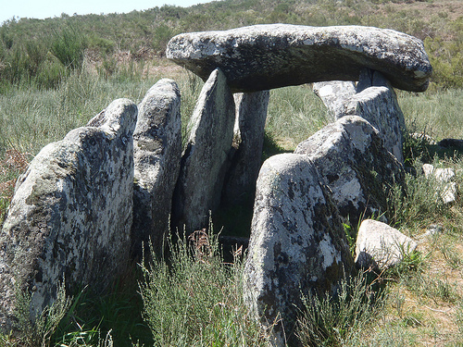
.
Orca da Malhada do Cambarinho
Michela Zucca
Servizi culturali

Slide 12
The lines were measured, their half-length determined on-site and a surveyorʼs rod placed on these points. These were then used to determine the axial direction az0. The “window” azimuths azN and azS were determined by using a surveyorʼs tape to extend the diagonals of the corridor further afield. The rods were then fixed
in these directions and used as foresight.
Michela Zucca
Servizi culturali

Slide 13
Half of the dolmens resulted oriented to the sun and the solstice; half were oriented to the moon and the stars. The results fit prehistoric beliefs in fertility religion and in the cult of the Earth-Mother Goddess: the solar dolmen were linked with masculine power (insemination) and the lunar ones with feminine force (reproduction), both necessary with the dominant feminine principle.
But dolmen orientation meant that our ancestors spent a long time looking at the stars….
Michela Zucca
Servizi culturali

Slide 14
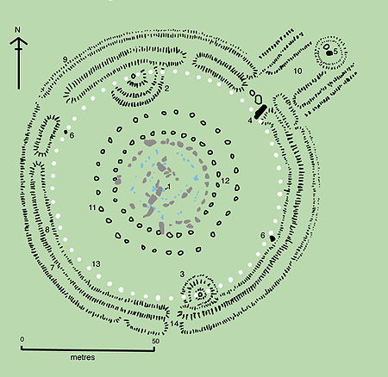
Cromlech is a celtic word, related to feminine power: Welsh, =crom bent, curved, crooked (feminine of crwm, crown + lech, comb. form of llech flat stone
Michela Zucca
Servizi culturali

Slide 15
The mathematical peculiarity of the Stonehenge 'Station-stones' having proportions that mirrors the latitude of the site, is only surpassed by the fact that both the Sun and the Moon (at their respective maximum settings) rise at approximately the same point on the horizon from the site, which is also mirrored in the latitude of 51° 51'.
This remarkable astronomical fact, and the quadrangle design occurs at two other known European locations, each of which demonstrates a relationship between their latitude, their internal geometry, and an astronomical relevance in their placement.
Michela Zucca
Servizi culturali

Slide 16
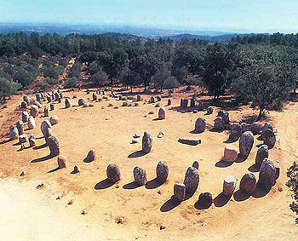
Over 130 megalithic sites exists in the alqueva region: it must have been of major importance
Michela Zucca
Servizi culturali

Slide 17
One of the crucial astronomical facts concerning Stonehenge is that it lies under one of two latitudes in the world at which the full moon passes directly overhead on its maximum Zeniths: the second in the world (at today’s knowledge) is in the cromlech of Almendres.
The site has been dated from 'various phases throughout the Neolithic period (4th to 5th millennium), by when it had acquired the look it has today' (Ref: Notice-board at site).
This is the oldest known
stone-circle in Europe.
Michela Zucca
Servizi culturali

Slide 18
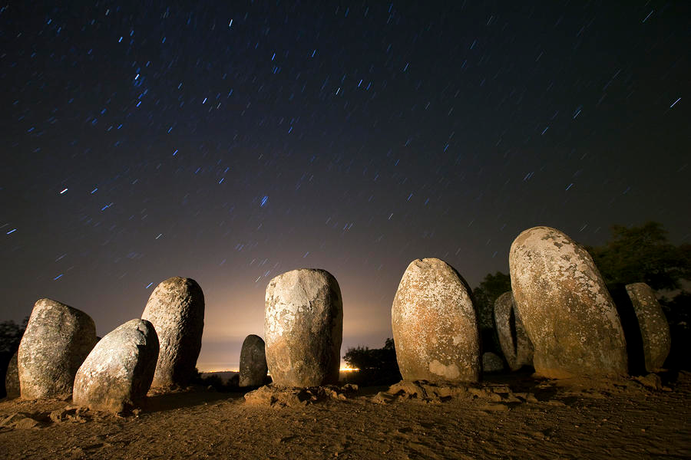
the latitude over which the Moon passes on its maximum settings cover it a 18.6 year cycle, and it is the same latitudes for both Stonehenge and Almendres (38˚ 33' N - Almendres) and (51° 10' N - Stonehenge). But Almerndres was built 2.000 years before.
Michela Zucca
Servizi culturali

Slide 19
The Almendres Circles are also the terminal point for an alignment which runs across Portugal for over 50km, connecting at least three of the most significant sites in the country together. If one stands at Almendres on the spring full moon, it will rise on the horizon at approximately 110° and travel directly towards you, passing first over the (now relocated) Xarez 'quadrangle', then over the largest passage mound in Iberia (Zambujeiro), which is orientated along the same azimuth with its opening facing the rising moon.
Michela Zucca
Servizi culturali

Slide 20
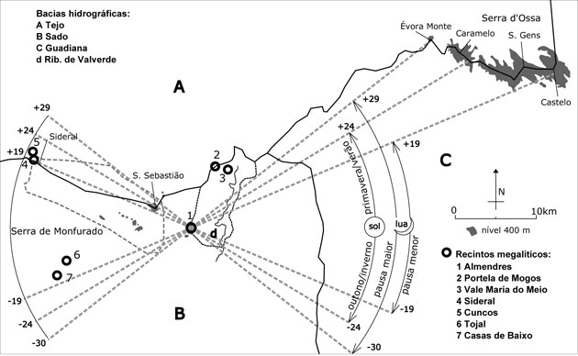
Almendres circle is one end of a 50km alignment which follows the azimuth of the spring full-moon (110°). It continues eastward passing the Zambujeiro passage-mound, ending at the Cromeleque da Xarez, near Monsaraz: it is the longest prehistoric alignment in Iberia.
Michela Zucca
Servizi culturali

Slide 21
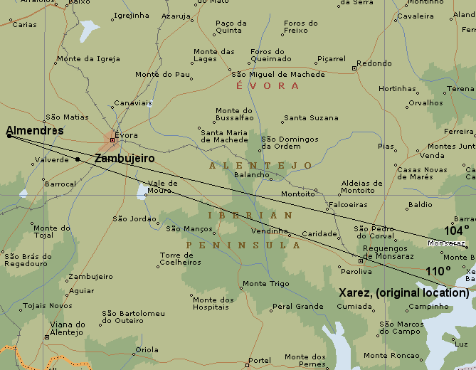
.
Michela Zucca
Servizi culturali

Slide 22
Both the Almendres circle and the Zambujeiro passage-mound belong to an alignment of sites which continues eastwards to the 'Cromeleque' da Xarez, around 50km away. The alignment is suggested to have a lunar significance, corresponding to the azimuth of the spring full-moon (110°), which is close enough to the equinox to have served as a marker . It is probably no coincidence that the Anta Grande da Zambujeiro was orientated to face the same direction.
Michela Zucca
Servizi culturali

Slide 23
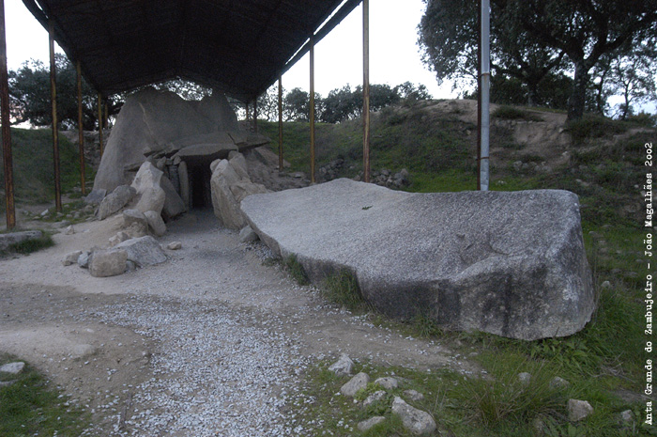
Anta Grande da Zambujeiro (V mill. B.C) is the biggest in Iberia.
it has a 12 metre long passageway and a chamber 8 metres high
constructed from 7 orthostats. The original capstone has
been removed and lays broken in two pieces. There are cup
marked stones before the front entrance.
Michela Zucca
Servizi culturali

Slide 24
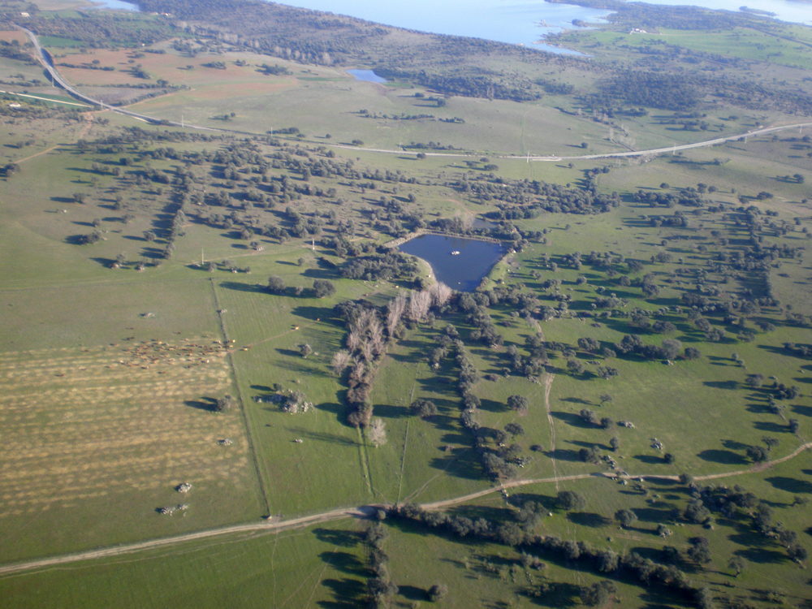
Over 130 megalithic sites exists in the alqueva region: it must have been of major importance
Michela Zucca
Servizi culturali

Slide 25
There are a handful of megalithic structures in Europe which whilst retaining an essential geometric design - are not circles.
As rare as they are, megalithic quadrangles are found at some of the most significant sites in Europe. The Station stones at Stonehenge are probably the most famous, but quadrangles are also found at Carnac, France; and near in MOsaraz, Portugal: All of which are areas of megalithic and astronomical significance.
.
Michela Zucca
Servizi culturali

Slide 26
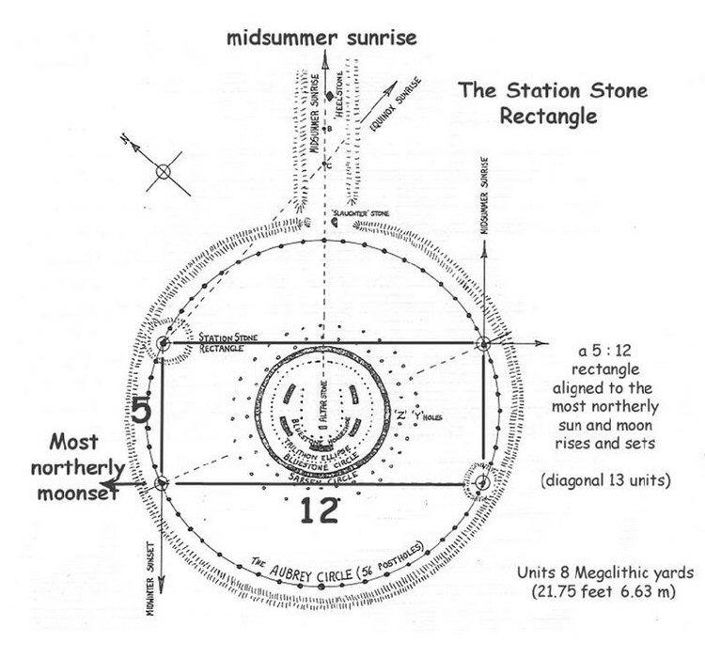
The oldest Stonehenge was quadrangular, and moon oriented, like Monsaraz altough it is commonly known for its solar orientation.
Michela Zucca
Servizi culturali

Slide 27
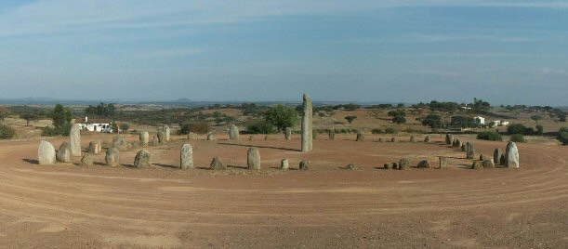
the monument was probably erected between 4,000 and 3,000 BC (1.000 years before Stonehenge). its original design was quadrangular, consisting of 55 menhirs (55.8 = 3 x 18.6), three full lunar cycles. The y are both phallic and rounded (some with “breasts”) as at Evora, confirming the fertility cults and the simbology masculine-feminine.
Michela Zucca
Servizi culturali

Slide 28
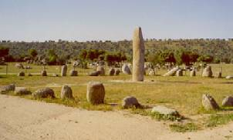
The 'Xarez' monument - before it was relocated
for the construction of the dam. But the big
cromlech was only one of the sacred megaliths of
the region ….
Michela Zucca
Servizi culturali

Slide 29
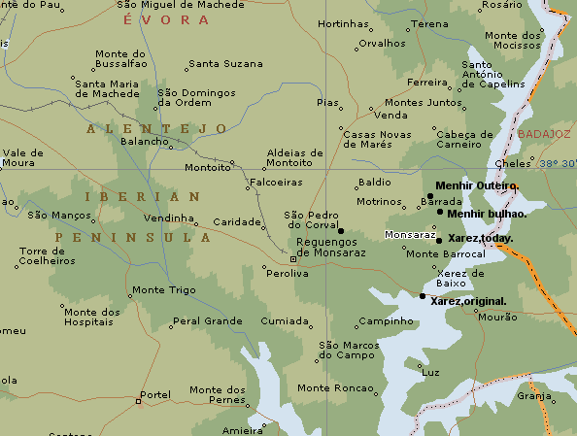
Over 130 megalithic sites have been recorded in the surrounding countrysid of the Alqueva lake.
Michela Zucca
Servizi culturali

Slide 30
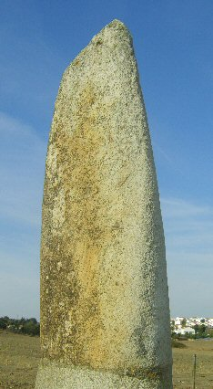
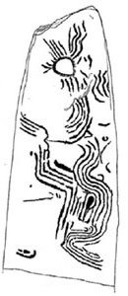
Menhir Bulhão: 5- 6th millennia BC, is the earliest monument in the region. There are several engravings still visible on the upper-half : a 'sun' shaped symbol, several 'crook's', and 'serpentine-wavy' lines, familiar to the engravings in Gavr'inis passage-mound in France, similarly
dated around 4,500 BC.
.
Michela Zucca
Servizi culturali

Slide 31
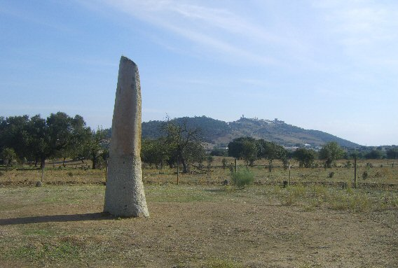
Menhirs were males and females.
The peak of Monsaraz lies exactly 180° to the South, although the natural orientation of the stone follows the proposed 100° azimuth of the spring moon. The general tapering end and 'fin-like' profile reasonably preclude it from having had any association to phallus. It was associated with the moon.
.
Michela Zucca
Servizi culturali

Slide 32
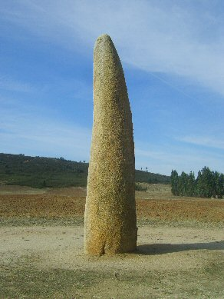
Menhir of Outeiro:
About 3km (2 miles) north of Monsaraz, is the tallest (5.6m/18ft), menhir in the region, and second only in size to the Menir Meada, near Castelo de Vide in all Iberia. The stone weighs around 8 tons and was beautifully shaped and erected to lead an apparently solitary life in the flatlands, with Monsaraz alone looming in the background. There is a slight depression along the top which has led to the common assumption that it was originally phallic by design.
.
Michela Zucca
Servizi culturali

Slide 33
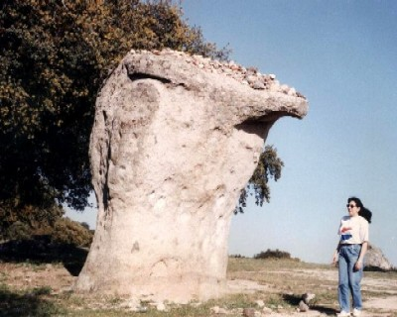
Roche das Namorados: is actually a natural granite outcrop. It is occasionally referred to as 'mushroom-shaped' or 'Uterus' shaped, but its shape varies depending on where one stands. The stone has several large 'dimples' or 'cup-marks' on it.
.
It is said that if a woman stands with her back to it and throws stones onto it, the number of attempts represents how many years it will be until she gets married. The 'Christianisition ' done engravings
cross on its surface shows its importance in women fertility rituals still practised in historic times.
Michela Zucca
Servizi culturali

Slide 34
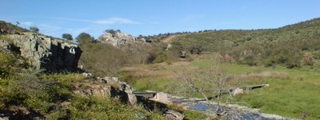
The megalithic culture developed in the so called “celtic culture”. In southern Portugal, it was connected with a healing deity, Endovelicus. In the municipality of Alandroal, there is the Santuário da Rocha da Mina , the temple of Endovelicus. Near the temple, we can find the Lucefecit rivulet that has been associated with Lucifer since the Middle Ages. Lucifer was the name used by the Romans for the Morning
star and the goddess Venus. Still, a link to the stars , to the moon, and to the goddess related to fertility.
Michela Zucca
Servizi culturali

Slide 35
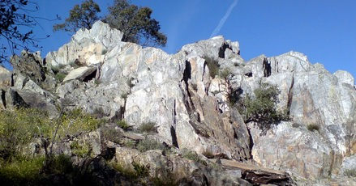
Some authors connect the name of the rivulet with the meaning "Glimpse of Light“: that can be star. A kilometer away, there is a sacred fountain that is said to be more ancient than the temple; its waters are still considered medicinal. All the rock resembles a bridge to the sky and a natural astronomic observatory.
Michela Zucca
Servizi culturali

Slide 36
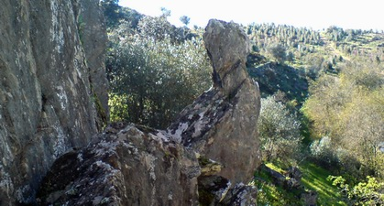
Rocha da Mina is a natural megalith. In the archaic times, stones are the bones of the Mother Earth, and menhirs put in communication the subterranean world and the sky. In Portugal prehistoric settlements were built around these big rocks, natural menhirs from where you could observe the sky and predict future.
Michela Zucca
Servizi culturali

Slide 37
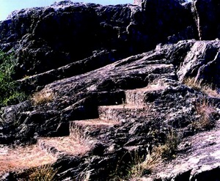
….
Michela Zucca
Servizi culturali

Slide 38
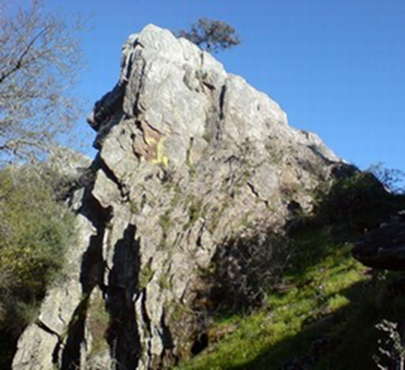
The highest peak is a natural site of observation Probably, astronomy was used to foretell future events through movements of the star. We know they knew astrology and
zodiac.
Michela Zucca
Servizi culturali

Slide 39
New Christian religion was not interested in astronomy: the Earth was the center of the universe, it was dangerous to look at the stars. The only place where astronomy survived was Ireland: catholic priests inherited knowledge of the ancient druids, and bishop Cormac Mac Cuileannain (836-908) wrote that “Any intelligent person can estimate the time of night throughout the year studying the position of the moon and the stars”. In the Psalter of Quatrains, X sec., is written that "The educated people in Ireland should know the signs of the Zodiac with their names in the correct order, and the exact month and day when the Sun enters each sign“. St. Virgil (Virgil the Geometer), abbot and later bishop in Salzburg, previously an Irishman named Fergal, in a letter of 748 stated that “There are under the earth another world and other men and Sun and Moon“. More or less in the same years, the Venerable Bede, a Benedictine of Northumbria, explicitly wrote: “Terra rotunda est“. But celtic
monks were forgotten and their knowledge banned.
Michela Zucca
Servizi culturali

Slide 40
People who knew were obliged to hide. Every year we discover old pieces of parchment where some of the ancient Irish druids-monks jotted down their observations about the universe and calculated eclipses, solstices and equinoxes. But most of that heritage is still unknown, and is waiting to be rescued.
Michela Zucca
Servizi culturali

Slide 41
THANK YOU
Michela Zucca
Servizi culturali

