Slide 1
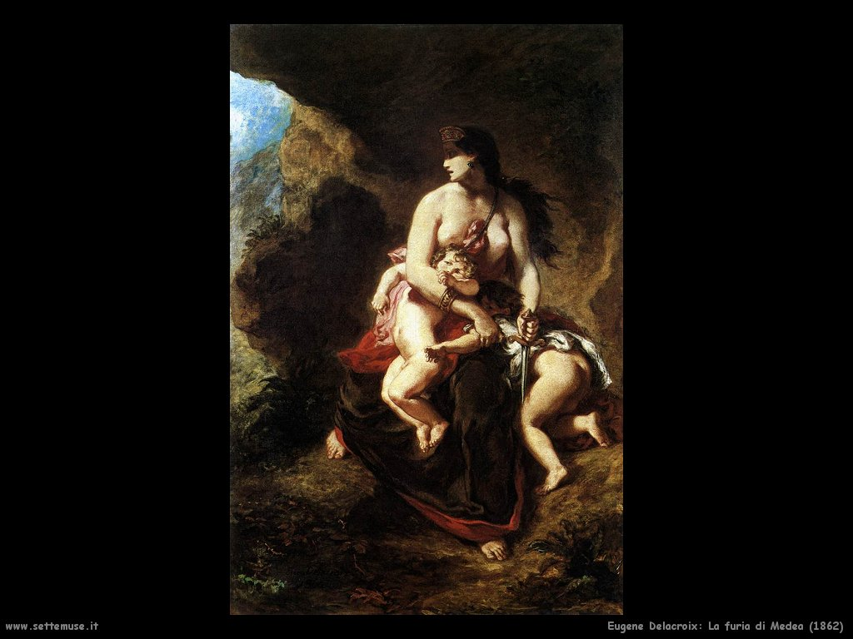
Mothers Killing their Children in
Italian Alps
Michela Zucca
Associazione Sherwood

Slide 2
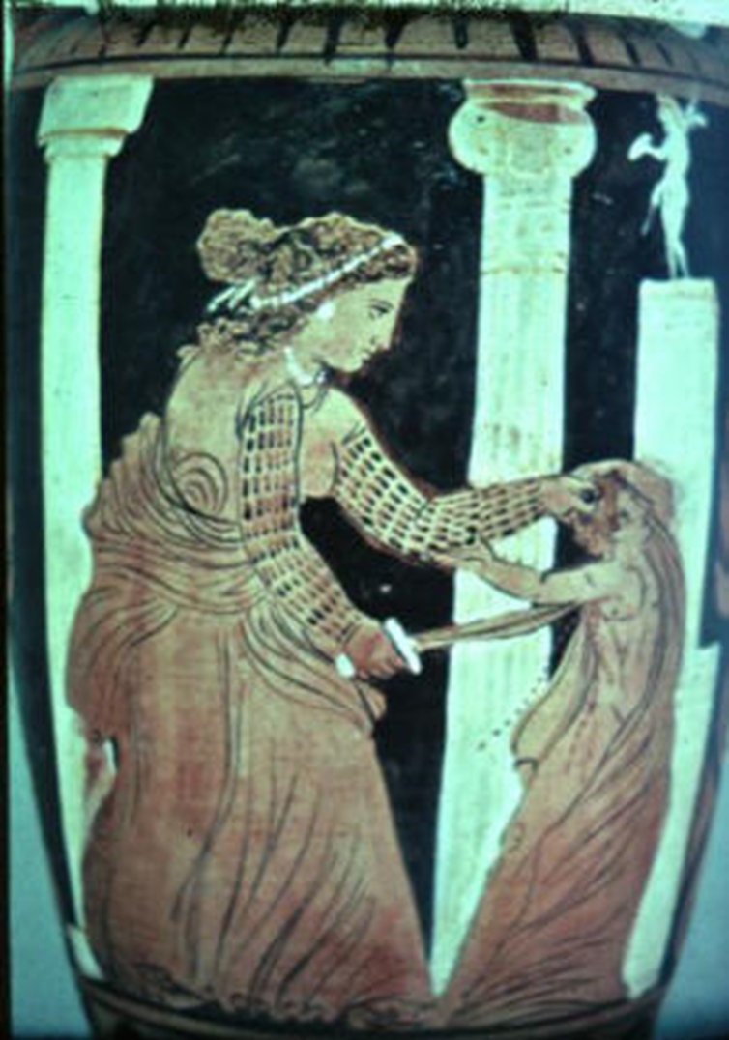
Ancient Greeks had already understood everything: and they entrusted the story of female distress to a myth.
Medea, the witch queen, a wise woman who leaves everything to follow her man, when he abandons her kills the children he had from him.
Michela Zucca
Associazione Sherwood

Slide 3
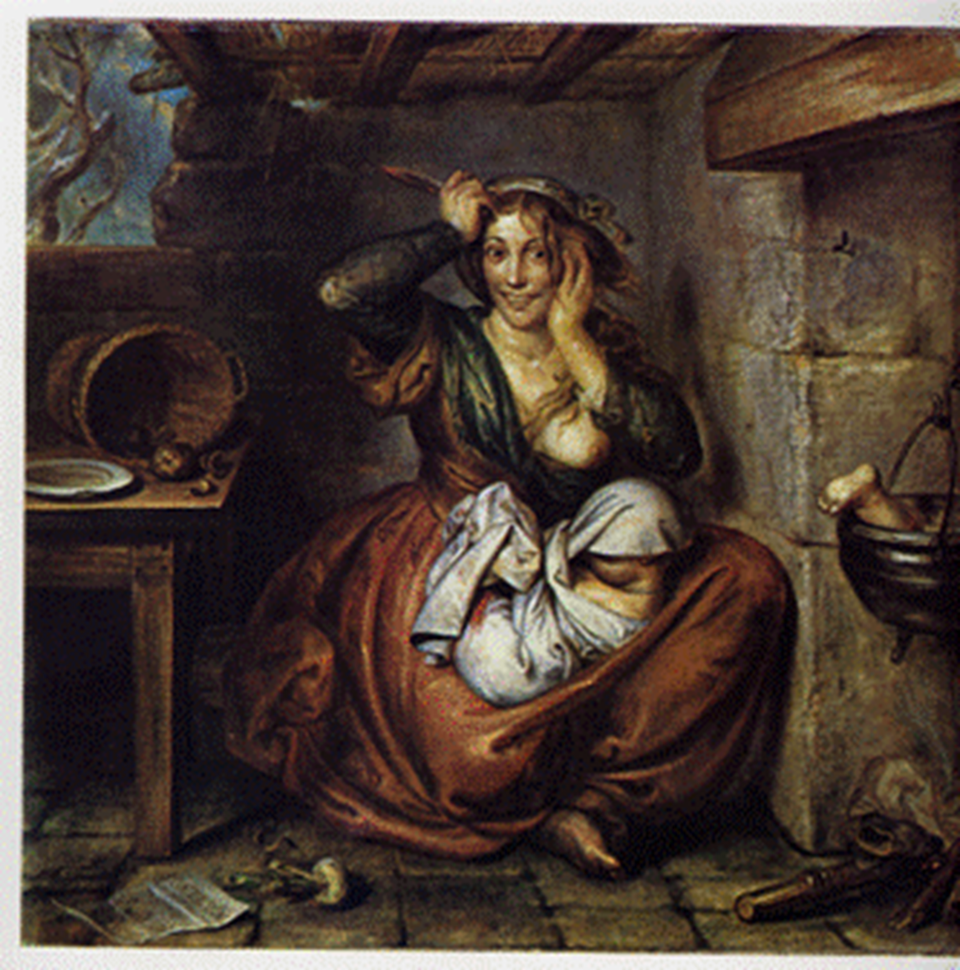
Infanticide has always been a result of poverty, widespread in those environments where the mother feared being thrown out on the street and could not count on any protection. It was the typical crime of young servants, girls coming from the countryside
to work in
big cities.
Michela Zucca
Associazione Sherwood

Slide 4
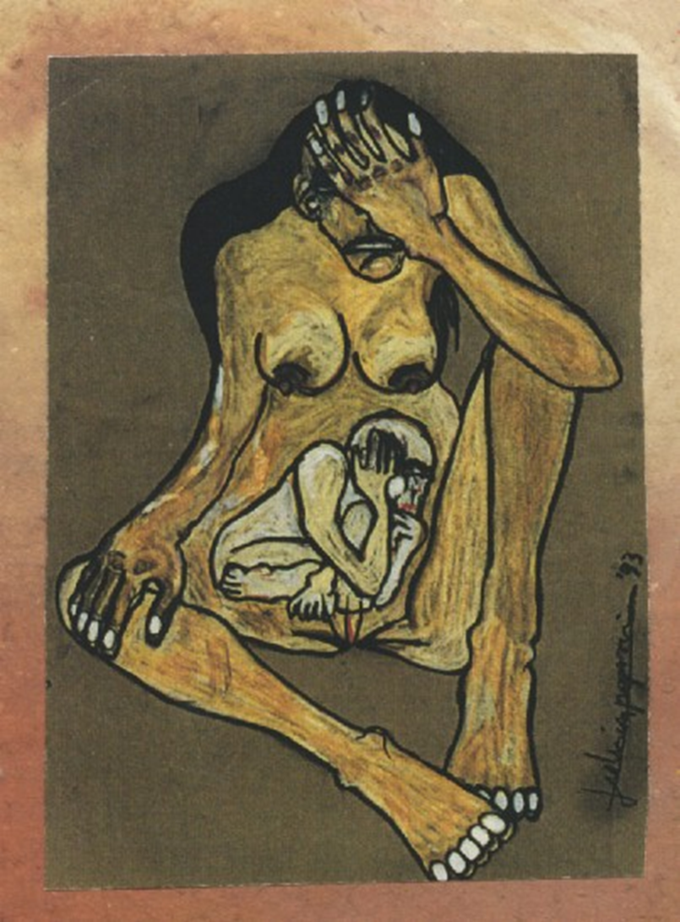
Today it is an increasing phenomenon especially among foreign carers, often clandestine, who are afraid of being hunted and sent home. As you can see, history repeats itself ...
Michela Zucca
Associazione Sherwood

Slide 5
INFANTICIDE CAUSED BY «DEPRESSION»
It is an increasing phenomenon especially in small mountain villages.
It is attributed to "postpartum depression" even when the partum has passed for many years.
There is a social motivation for this type of depression: an anthropological context that favors filicide.
The religious tradition is an integral part of this culture: women must put family and care before anything else. This is thought as «natural»
and if you feel discomfort you must be silent.
Michela Zucca
Associazione Sherwood

Slide 6
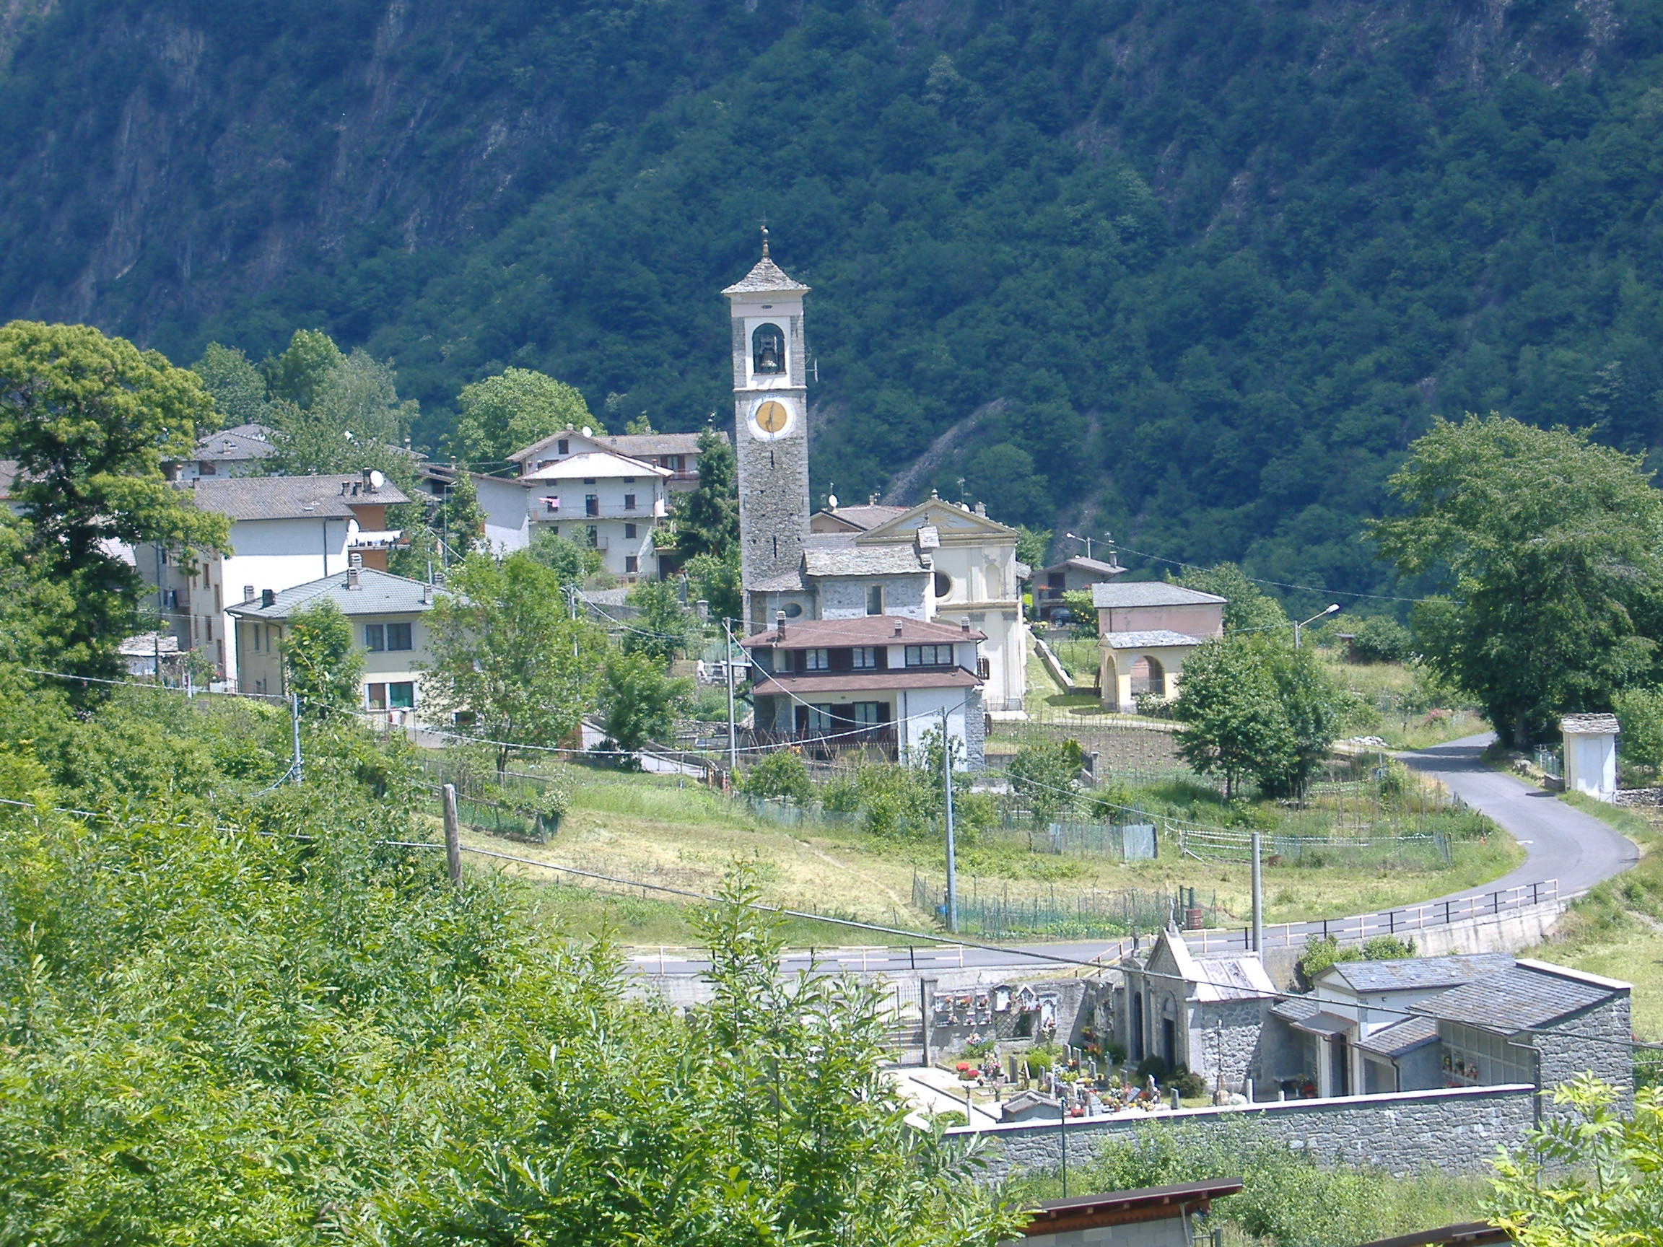
Most villages of Italian Alps have undergone severe processes of depopulation. In the last decades, expecially women left. Reasons for fleeing were not only economic: it was a strong refusal of pathriarcal society.
him.
Michela Zucca
Associazione Sherwood

Slide 7
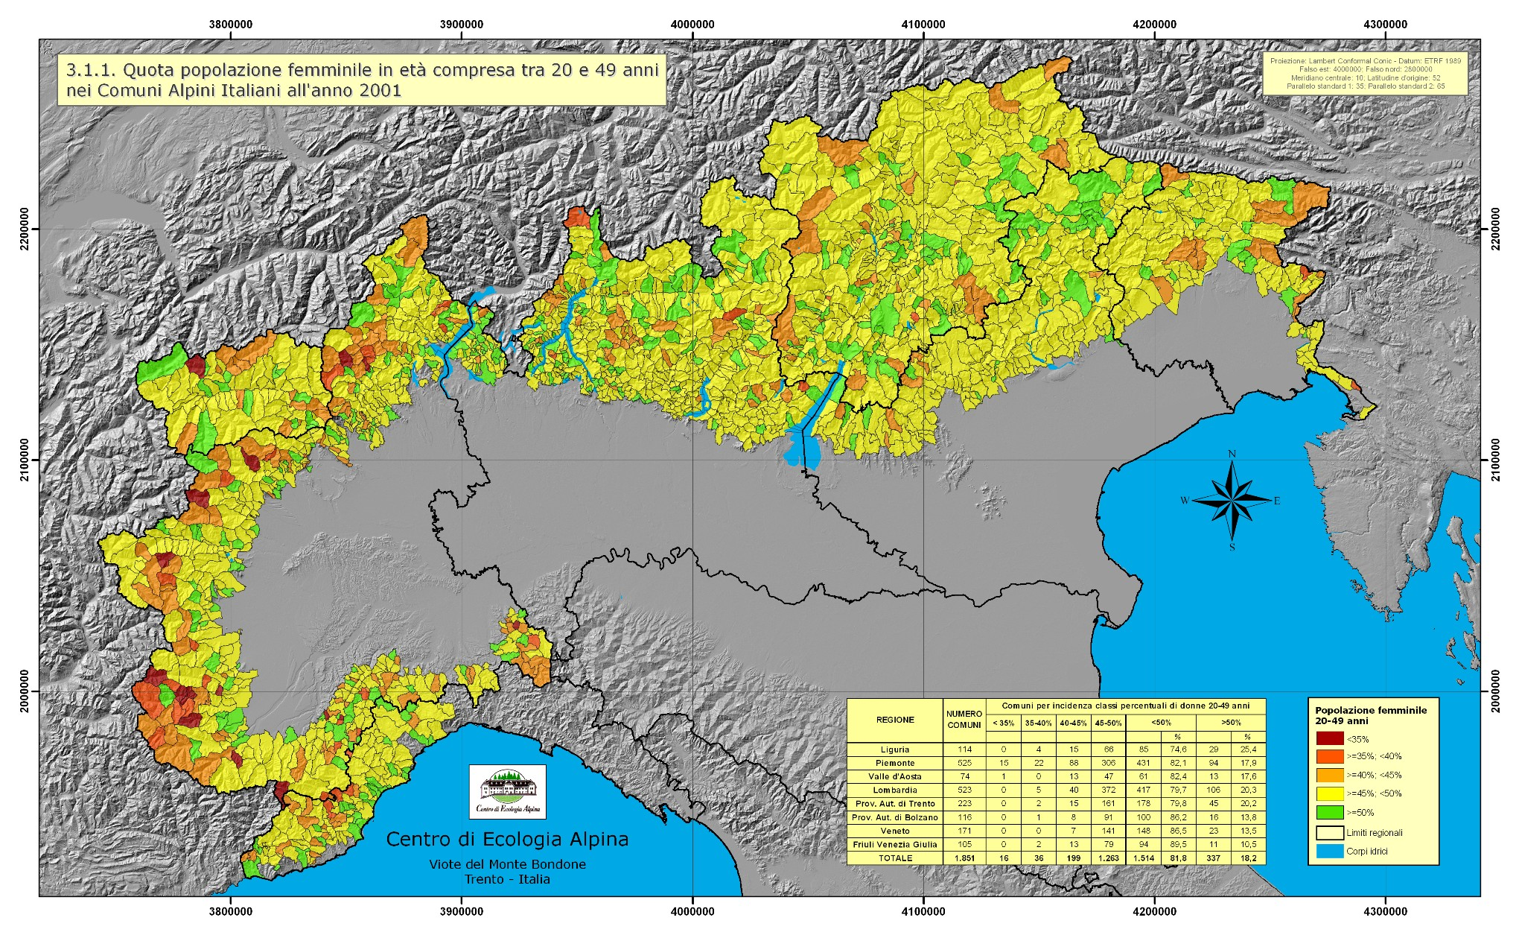
Gender depopulation begun in the ‘60 and had increased year by year, depriving mountain villages of their reproductive factor: the female component.
Michela Zucca
Associazione Sherwood

Slide 8
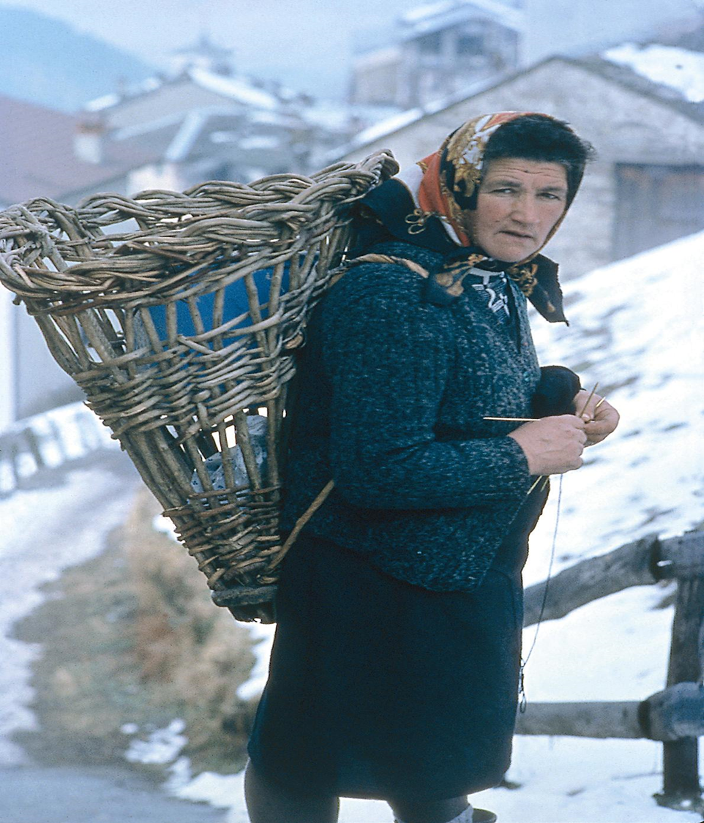
Women who accepted to stay had to adhere fully to the traditional model of life. That meant man working outside, commuting on long distances and coming home late at night, on weekends or for holidays.
Val Tartano Valley, Sondrio, beginning of ‘90
Michela Zucca
Associazione Sherwood

Slide 9
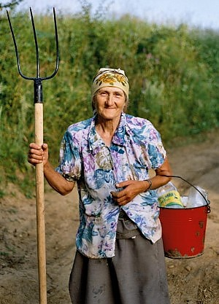
All primary production is entrusted to the woman. Reproduction work, which includes the care of bodies (human and animals) and food sources. It is a never ending work: hearth beasts and men must be looked after during holidays too.
This is work that is mostly unpaid. It is based on the sense of duty. This moral obligation is rooted in Catholic religion.
Michela Zucca
Associazione Sherwood

Slide 10
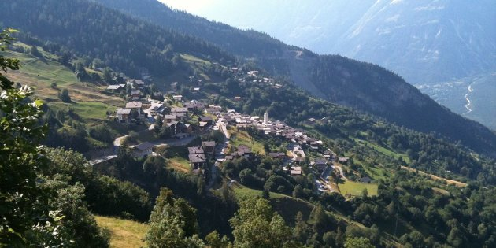
Depopulation in rural and mountain areas meant the State progressive disappearance. Schools, health services, post offices, public libraries, just close. Municipalities are melted together and offices close. No more town councils. So happens for shops and pubs, let alone cinemas, theatres, and any other place where people used to meet.
Michela Zucca
Associazione Sherwood

Slide 11
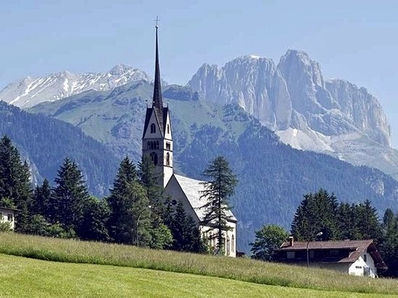
Gender depopulation begun in the ‘60 and had increased year by year, depriving mountain villages of their reproductive factor: the female component.
In this kind of situations, the only institution that organised itself to remain is the Church.
Michela Zucca
Associazione Sherwood

Slide 12
There is a substantial dichotomy between expectations of the social context and requests from the female counterpart. Demands addressed to married or "mature" women are still caring for the family despite working outside home, regardless of the profession and the commitment that this requires: in short, to "sacrifice" for the good of others. The concept of sacrifice is an integral part of the Catholic religion. In small villages, one of the few opportunities for socially accepted female aggregation revolves around the Church: oratory, parish council, voluntary service ....... areas in which the traditional vision of the female role in
the service of the family is perpetuated.
Michela Zucca
Associazione Sherwood

Slide 13
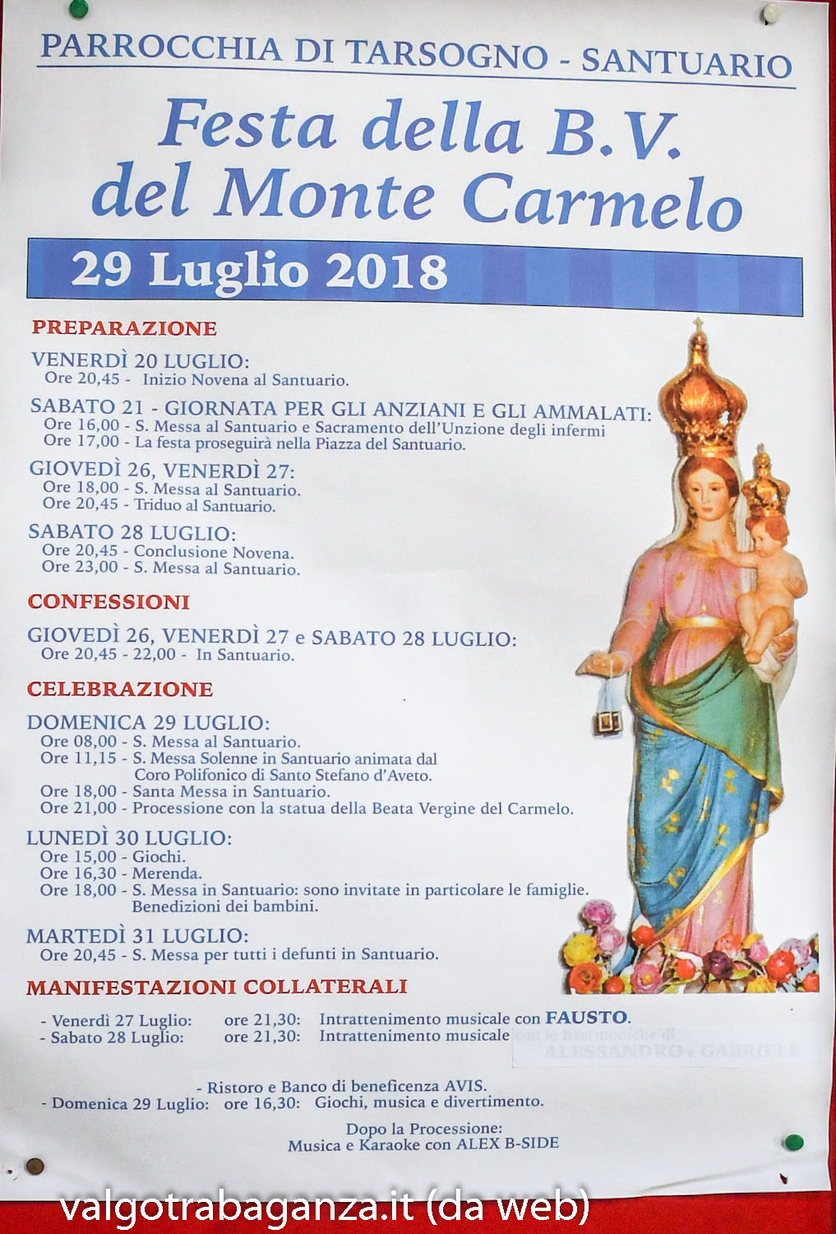
Where the structure of the secular establishment simply vanished, the Catholic ones resisted and gained in importance. They are based principally in children, and then in women involvement in parish councils and events organization.
The Church network is perceived of capital importance for the existence and resistance community (it does not matter of believers of not) in its founding values and therefore its participation is supported.
Michela Zucca
Associazione Sherwood

Slide 14
Who does not accept the traditional role, goes away, or suffers. The fear of "voices" takes on persecutory aspects: in one of the villages where we worked, one of the few young mothers who graduated in university refused a managerial position in her own municipality, which would have allowed her to reconcile work and family commitments, taking on tens of kilometers of daily commute, for fear of the criticism of the villagers. Even more than their male peers, girls seek friendships outside, which can provide excuses to get out of a social, religious and family context experienced as suffocating as soon as possible.
Michela Zucca
Associazione Sherwood

Slide 15
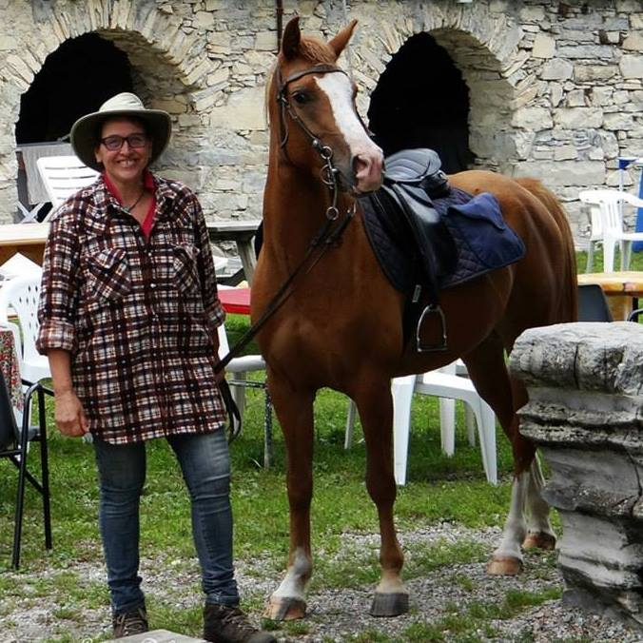
All the mountain economic and social system is based on women unpaid work, much more than in towns. Church justifies the effort.
Ossuccio (Como)
Michela Zucca
Associazione Sherwood

Slide 16
For males it is different. After being married, man is still free to have a personal life, to carry out activities in his free time (sports, even competitive, mountain rescue, volunteering; ...), to visit friends (outside the domestic context which, as we have seen, remains closed and private). On the contrary, the married woman once she has finished work must go home. Unthinkable that you leave your children with your husband to go to the bar every night before returning, that twice a week you spend the evening playing cards with friends or in the gym to train, go away for whole days to go hunting, whether he spends his Sunday on the ski fields or fishing, spending money for himself (although she works professionally), which his husband can easily do once the family's needs have been met.
Michela Zucca
Associazione Sherwood

Slide 17
OTHERWISE FOR WOMEN, EDUCATION TO OBEDIENCE AND TO SACRIFICE BEGINS SINCE CHILDHOOD: AND CATECHISM HAS BIG RESPONSIBILITY IN THIS
For boys, vivacity is forgiven, girls are asked to be nice
Little girls are not used to using the body to defend themselves: they are asked to be understanding and to talk
Girls are taught systematically that peers are the strongest and that it is unseemly to fight and get your clothes dirty
In the family they see mothers serving the
males, considered incapable of "getting things
done".
Michela Zucca
Associazione Sherwood

Slide 18
Even today, women have no right to pleasure: they cannot even claim the right to leisure. Getting caught “doing nothing" is considered very bad. If the ladies decide to be together, they must invent a good excuse, possibly productive but not for themselves, for the community, or for the Church, because they cannot waste time on "useless things" and cannot show that they are "greedy" by claiming their own will of profit.
Michela Zucca
Associazione Sherwood

Slide 19
Conditions of severe social pressure, ignored and not recognized by the context, can lead to the emergence of phenomena of discomfort that can lead to extreme situations: in recent years, cases of "killer mothers" in the Alps and in rural areas of Italy have been repeated, due to apparently inexplicable depression.
When one of these facts happens, the Church is at the forefront of talking about personal responsibility and the mother's
criminal choice.
Michela Zucca
Associazione Sherwood

Slide 20
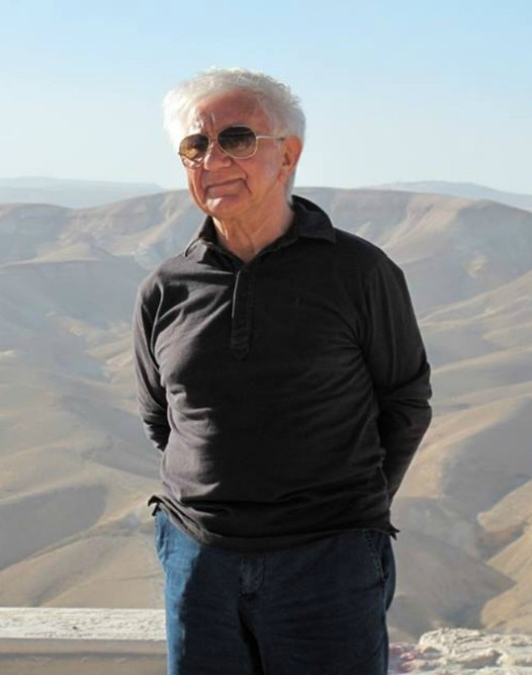
When I first presented the result of this research, one of the murders just happened the day before near the place I was talking. One of the bets known Italian catholic opinion makers, a priest called Antonio Mazzi, wrote an arcticle on the biggest newspaper against me, declaring that “responsibility is always personal” and the contexct “simply does not exist”...
Michela Zucca
Associazione Sherwood

Slide 21
THE NORMAL SOCIAL ENVIRONMENT. WHEN THE PRESSURE REACHES A POINT OF NON-RETURN
Suffocating social climate, (obliged) closeness to the family of origin of partner, fear of criticism and gossip, duty of sacrifice, loneliness, non-recognition of symptoms of depression by husbands and family members, can cause serious forms of discomfort, abuse of psychotropic
drugs, suicide or infanticide.
Michela Zucca
Associazione Sherwood

Slide 22
CASES UNDER CONSIDERATION:
Cogne (Ao),
Montjovet (Ao),
Santa Caterina Valfurva (So)
Casatenovo (Lc),
Merano (Bz)
Michela Zucca
Associazione Sherwood

Slide 23
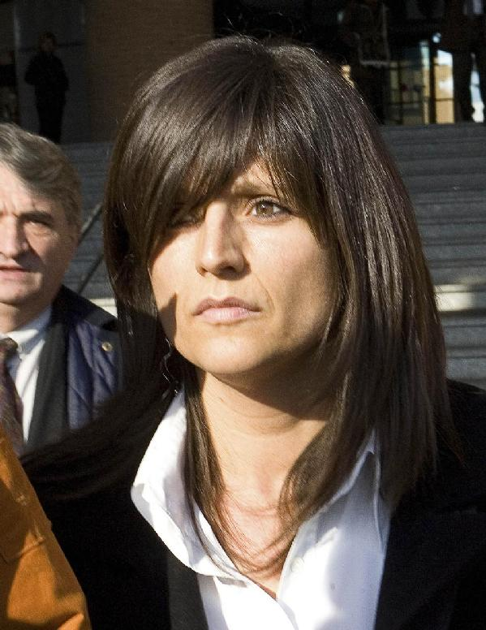
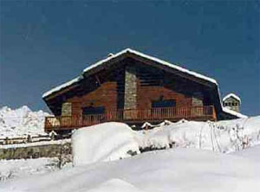
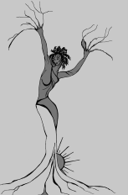
Anna Maria Franzoni
Housewife.
She comes from outside.
A very busy husband in the municipality and in volunteering.
Takes antidepressants.
She is alone.
No help.
Far family of origin.
She lives in a single house isolated from the village.
She has few social relationships.
She left a profession to look after his children.
Michela Zucca
Servizi Culturali

Slide 24
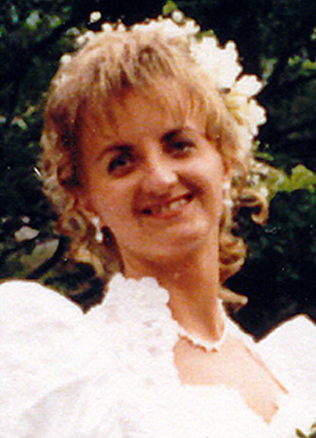
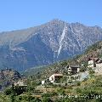
Olga Cerise
Housewife.
She comes from outside.
Husband very busy at work.
Takes antidepressants.
She is alone.
No help.
Far family of origin. She kills her two children on a Sunday: the second has 24 days.
She went to her parents alone by car. Her husband had to accompany his parents to Sunday Mass. It's very hot. She goes to the lake to get some fresh air, and she drowns them both. She lives in a small hamlet, in a single house.
Michela Zucca
Servizi Culturali

Slide 25
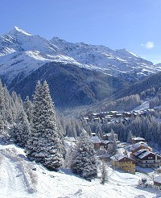
Loretta Zen
Housewife.
Husband very involved in competitive sport: he is a skyrunner.
Takes antidepressants.
On Saturday she is taken to the emergency room in Bormio’s hospital and doctors give her a good dose of psychotropic drugs.
On Sundays, her husband goes for a race as usual. She puts the smallest girl in the washing machine. She lives in a small hamlet, in a single house.
Michela Zucca
Associazione Sherwood

Slide 26
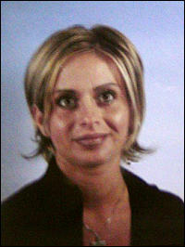
Maria Patrizio
She's on maternity leave.
Even before, he worked part time in a bakery. His collaboration on a private television, as a hobby, is seen by all as a freak that he will have to abandon sooner or later.
She takes antidepressants.
She is left alone: ​​her husband is working when she commits the murder. She lives in a small hamlet, in a farmhouse.
Michela Zucca
Associazione Sherwood

Slide 27
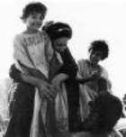
Christina Rainer
She is perpetually in motherhood. They call her the woman with the belly, because she has a child every three years: when one goes to kindergarten, she does another. Housewife, she hasn't slept for years. She takes psychiatric drugs. Zero social life, neither in Merano, nor in the village of her husband.
The only help is the mother, but she dies. The husband is very busy in work, in mountain rescue. He is head of the Civil Protection.
She is left alone: ​​her husband is working when she commits the murder. She lives in a tenement, but she doesn't go to anyone: both in Merano and in his husband's village in Fiemme Valley, no one has ever been to her house and in "free" moments (she has three young children) she works in the vegetable garden.
Michela Zucca
Associazione Sherwood

Slide 28
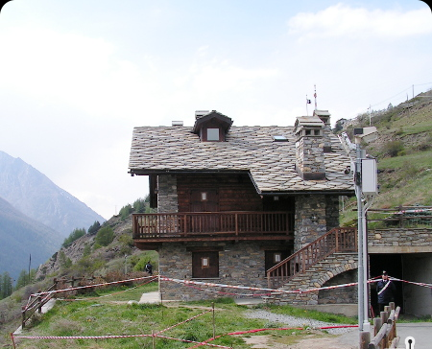
Almos all lives in single beautiful houses, or in farmhouses. This king of livelihoods should be impossible until few decades ago: in villages inhabitants lived close, many people in little rooms, for problems of heating and snow cleaning in Winter. The nuclear family simply did not exist. A mother with children always had a lot of people around her.
The loss of extended families has burdened women work. Mothers live in loneliness: in the past they could have the mother in law, and hate her. But she was another woman who could realise when you were going to kill your child…..
Michela Zucca
Associazione Sherwood

Slide 29
In all these cases, mothers are young, without economic or family problems, in "good relations" with their husband. They live in rural areas, in beautiful houses, owned by them. No economic problems. The man is always called "a great guy who works from morning to night thinking only of the family". No violence or beating is reported. The cultural level is generally low. Usually they are housewives; but even if they work outside, employment is frequently at half time, unqualified and undemanding (none is a career woman). According to the common mentality, they should have the time and the opportunity to dedicate themselves to their children. Alone, of course. The only one who they can ask for help is their mother: who costs nothing and, if a widow, is culturally obliged to help her daughter. However, if she dies, her figure is not replaced, even at the
birth of another child (the third as in Merano).
Michela Zucca
Associazione Sherwood

Slide 30
Each time, the husband is absent: in Cogne, frequently involved in politics; in Montjovet, he left his wife only 24 days after giving birth to accompany his parents to Mass and then help them mow and she was driving around alone with two children; in Santa Caterina, he left his wife alone with two small children to go for a race in the mountains; in Brianza, and in Merano, he was at work. Even though they knew that for months or years, their wives "no longer slept“ and they had been under psychiatruic drugs for months and even years.
Michela Zucca
Associazione Sherwood

Slide 31
In half of the cases, it was already known, and since long time, that the woman was being treated by psychiatric services: Merano, Casatenovo, Santa Caterina. But, apart from the drugs, no one of them could enjoy help at home; nor was their condition considered "severe enough" to require assistance. Yet perhaps the fasmily had the economic means if to pay for help: if only their work was considered too heavy to be done without collaboration.
Michela Zucca
Associazione Sherwood

Slide 32
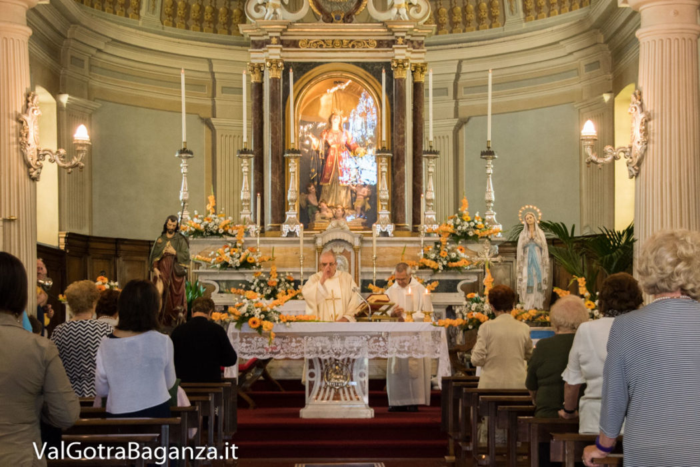
It is no coincidence that most of the filicides (2 on five) takes place on Sunday. And that one of the fathers had gone to Mass leaving his wife alone with two very young children. Filicide is an act of extreme protest against a system of values where you can not ask for help in name of duty. This sense of duty is perpetuated mostly by the Catholic Church.
Michela Zucca
Associazione Sherwood

Slide 33
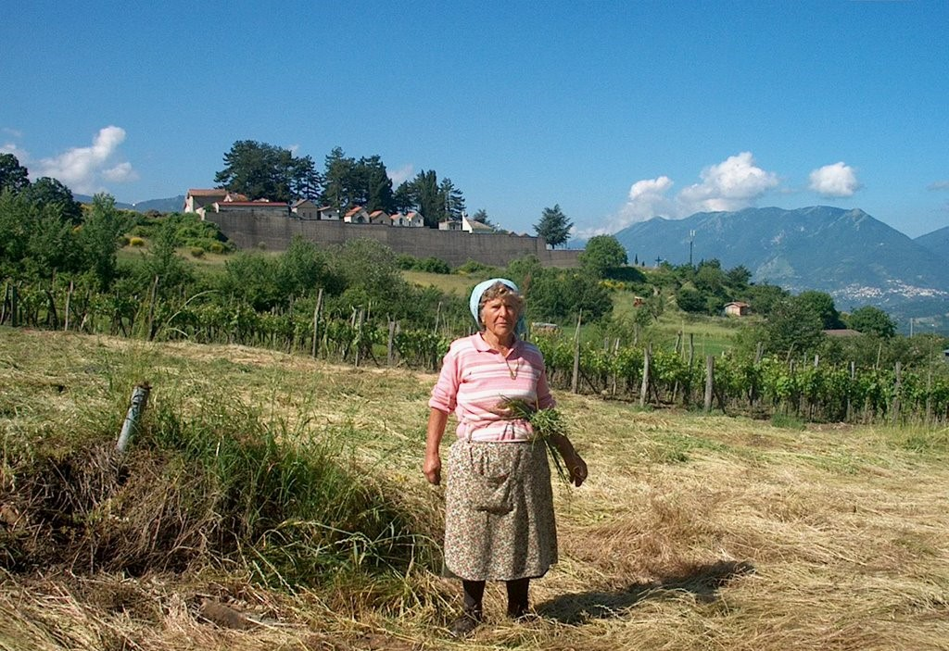
The traditional role of elder women, who were always together with young mothers, has vanished and everybody is alone in beautiful houses with all domestic comfort.
Michela Zucca
Associazione Sherwood

Slide 34
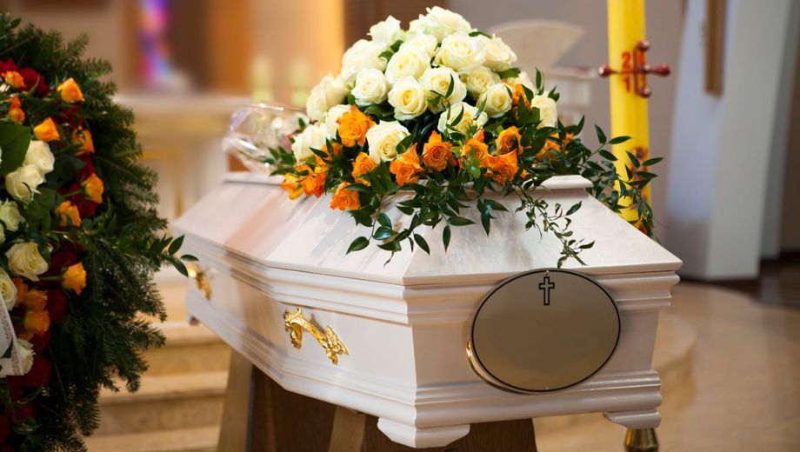
Without the possibility, or the cultural tools, to give responsibility of “depression” to an extremely demanding social context, the fault of all your hardship to live is attributed to the closest target: your child. If she, or he, were not born you could still sleep at night,
have had a lot of free time, look after yourself…. And you would not be judged
inadequate in your “natural” and “pleasant” role of mother, because the existence
of your child should “fill you with happiness”.
Michela Zucca
Associazione Sherwood

Slide 35
In these conditions, without the recognition of the anthropological context conditions, without admitting the need for help and the need for collaboration of the partner (in Italy there are less collaborative males from Europe), these cases are destined to increase.
Michela Zucca
Associazione Sherwood

Slide 36
THANK YOU
Michela Zucca
Servizi Culturali

